Slide 1

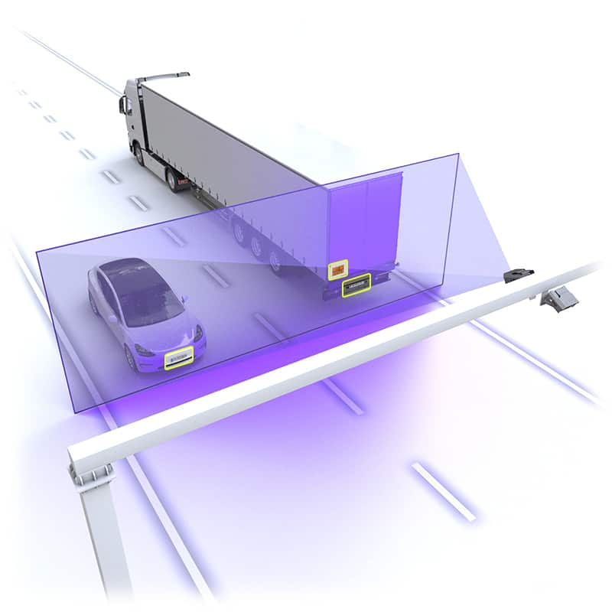
Adaptive Recognition
Company Presentation

Slide 2

We transform traffic cameras into intelligent eyes, ID scanners into trusted guardians, and everyday codes into valuable data points. Adaptive Recognition tackles complex challenges in traffic management, security, and identity verification with expert solutions, making the complex intuitive, and the impossible achievable.

Slide 3

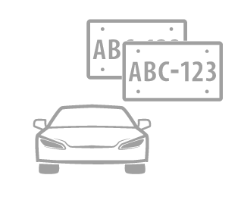

What We Do
We specialize in creating reliable software and hardware for license plate recognition, vehicle identification, and identity document reading and authentication.
Our Core Expertise
Our Focus
Our Products
Optical character recognition technology
Complex image analysis
for license plate recognition, vehicle identification and ID verification
ANPR and traffic analysis software and hardware (cameras), Passport readers and ID scanners
Confidential - property of Adaptive Recognition Hungary Inc.

Slide 4
Our History
Our milestones define our history – and our commitment today defines our future milestones.
1991
1992
1994
1996
1998
2000
2005
The Foundation of ARH
Release of our first license plate recognition software CARMEN
Access control system project at Budapest Airport
First foreign project
First purpose-built
ANPR cameras
First identity
document readers
Introducing our first software for container code reading
2022
2021
2020
2018
2006
New cameras for axle counting, passenger counting, and more
New ANPR cameras for parking access control
and for traffic monitoring
The ARH brand becomes Adaptive Recognition. Release of new cloud-based ANPR software
Building our worldwide representative network
Introducing our first passport reader with RFDI chip reading
Confidential - property of Adaptive Recognition Hungary Inc.

Slide 5
Our Operations & Approach
All operations conducted by in-house teams:
In-House Expertise and Control
Vertical Integration for Efficiency
End-to-End Solutions
Constant innovation and quick response to special requests:
Agile Innovation and Customization
Adaptability to Changing Needs
Dedicated to Customer Success
Strong focus on support
and long-lasting relationships
Committed to Customer Satisfaction
Collaborative Partnerships for Growth
Reliable Support and Service
Global network of partners and representatives
A Global Presence and Reach
Strategic Alliances Worldwide
International Expertise and Support
Confidential - property of Adaptive Recognition Hungary Inc.

Slide 6
Adaptive Recognition in Numbers
250.000 +
33 years
Installations worldwide
of experience
Insert data
38.000 +
Revenue/Turnover
License plate types
recognized
300 +
employees
Confidential - property of Adaptive Recognition Hungary Inc.

Slide 7
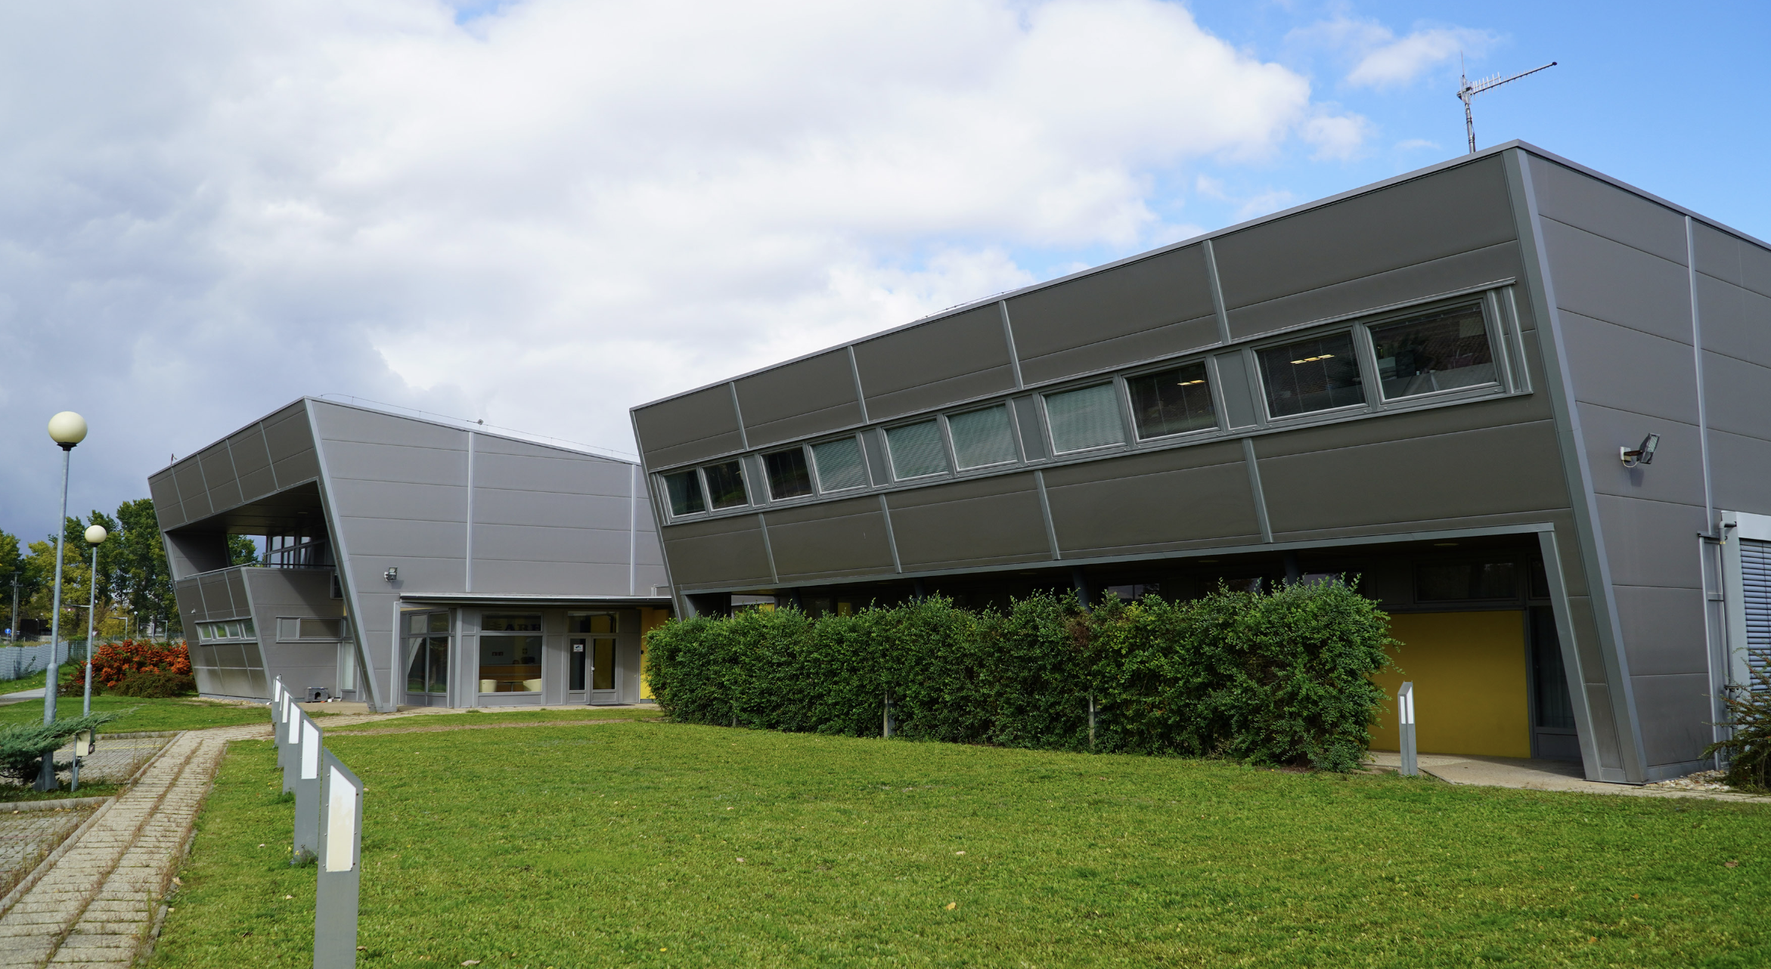
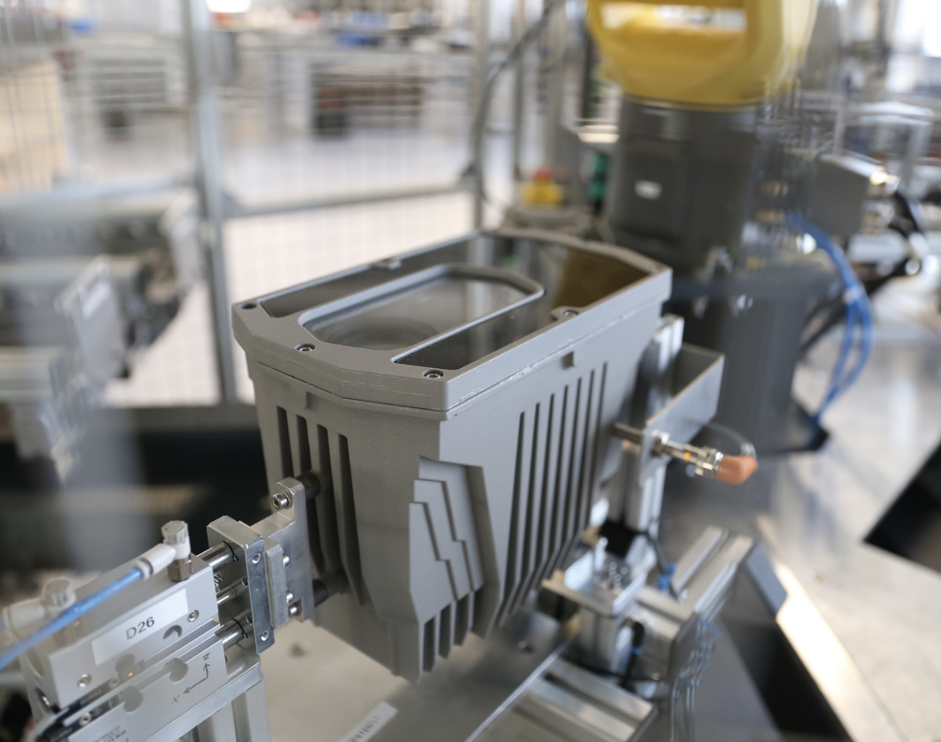
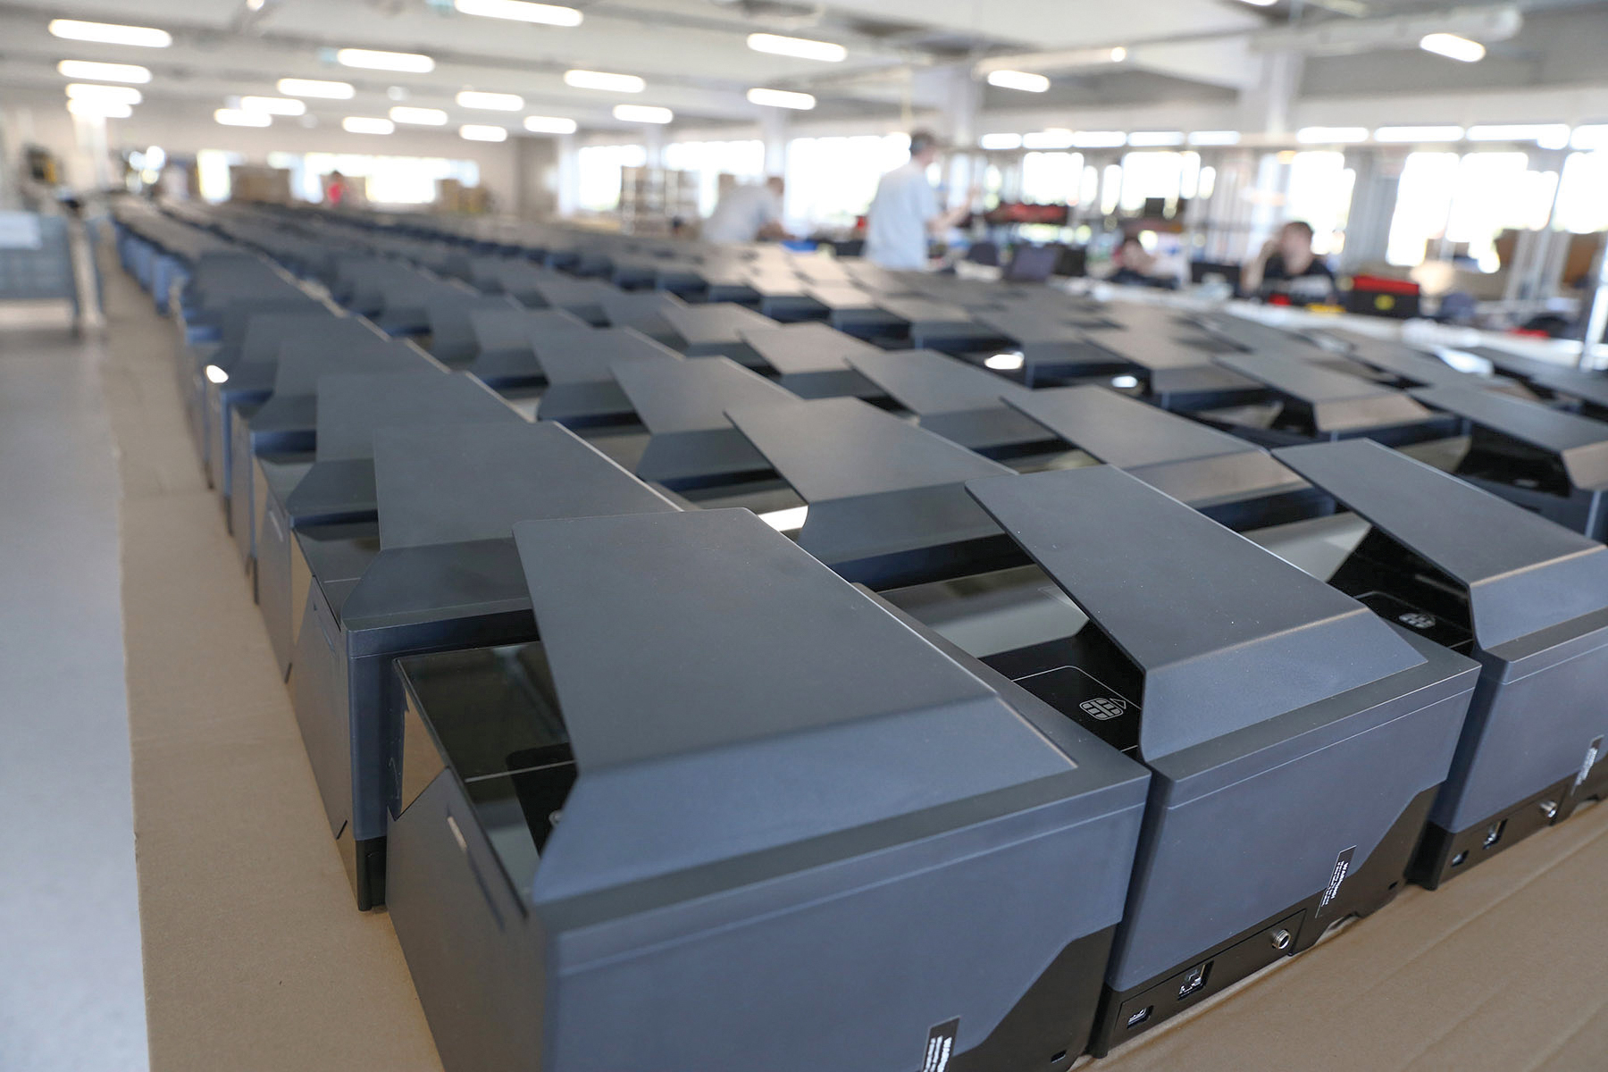
In-house Manufacturing
Our state-of-the-art manufacturing facility in Perbál, Hungary, is the heart of our hardware production. Here, we meticulously craft our high-quality cameras and ID scanners, ensuring strict adherence to industry standards and our commitment to excellence.
Confidential - property of Adaptive Recognition Hungary Inc.

Slide 8
Adaptive Recognition’s Offices
CZECK REPUBLIC
Office
SLOVAKIA
Office
SWEDEN
Office
NORWAY
Office
CANADA
Office
THAILAND
Office
UNITED STATES
Office
MALAYSIA
Office
PHILIPPINES
Office
SINGAPORE
Office
ITALY
Office
DUBAI
Office
INDONESIA
Office
DENMARK
Office
SERBIA
Office
HUNGARY
Office, Factory & Innovation Centre
Confidential - property of Adaptive Recognition Hungary Inc.

Slide 9
Adaptive Recognition’s Prime Partners
CZECK REPUBLIC
Office
SLOVAKIA
Office
SWEDEN
Office
Iceland
NORWAY
Office
Lithuania
Romania
Kazakhstan
CANADA
Office
Spain
Georgia
THAILAND
Office
UNITED STATES
Office
Macau S.A.R
MALAYSIA
Office
Hong Kong
PHILIPPINES
Office
Colombia
Nigeria
SINGAPORE
Office
ITALY
Office
DUBAI
Office
INDONESIA
Office
Australia
DENMARK
Office
SERBIA
Office
HUNGARY
Office, Factory & Innovation Centre
New Zealand
Confidential - property of Adaptive Recognition Hungary Inc.

Slide 10
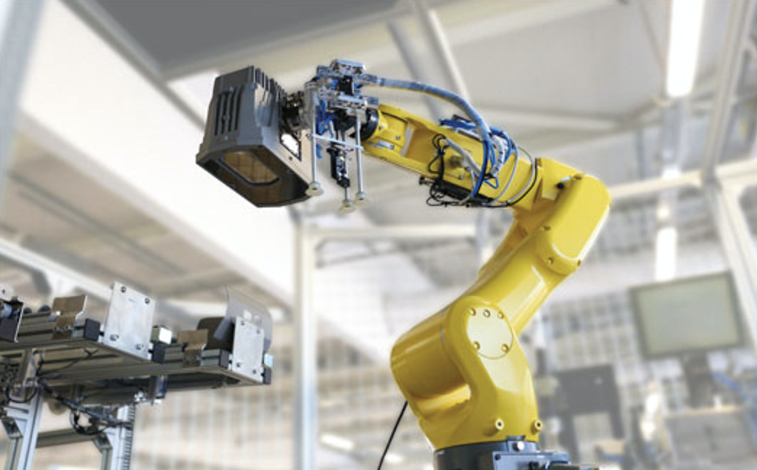


Certification
ISO 9001
Quality Management
ISO 14001
Environmental Management
ISO 27001
Information Security
Confidential - property of Adaptive Recognition Hungary Inc.

Slide 11
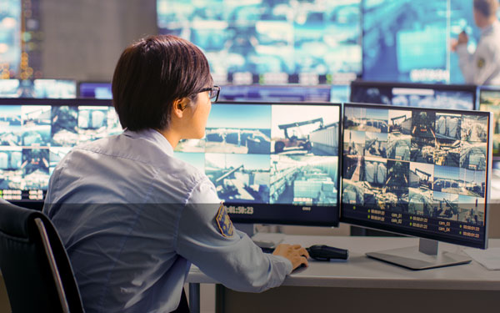

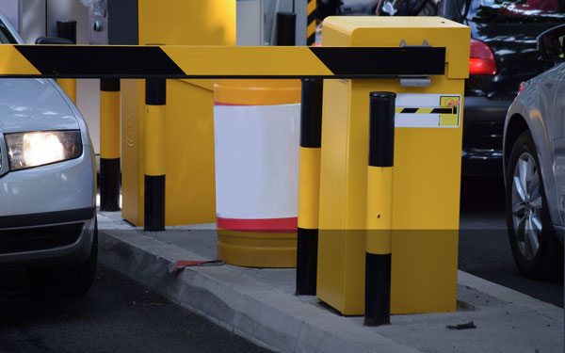


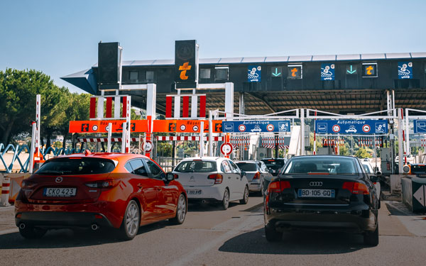

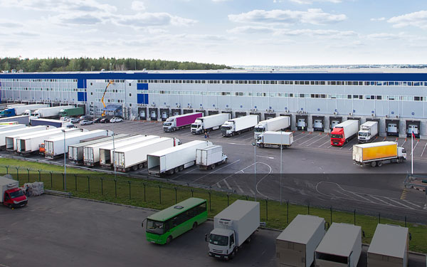
Application Areas
Security Operations
Air Travel & Border
Control
Parking & Vehicle
Access Control
Hospitality, Retail &
Gambling
Healthcare & Finance
Administration
Highway Tolling
Traffic Monitoring &
Enforcement
Logistics &
Transportation
Confidential - property of Adaptive Recognition Hungary Inc.

Slide 12

Trusted by over 1000 companies
Confidential - property of Adaptive Recognition Hungary Inc.

Slide 13
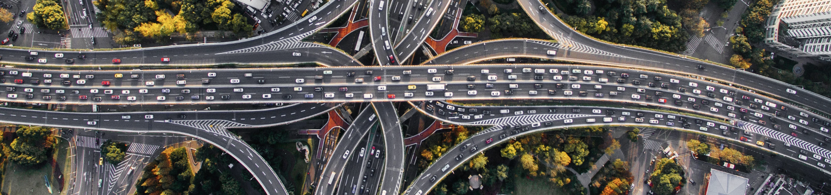
Product Portfolio Overview

Slide 14
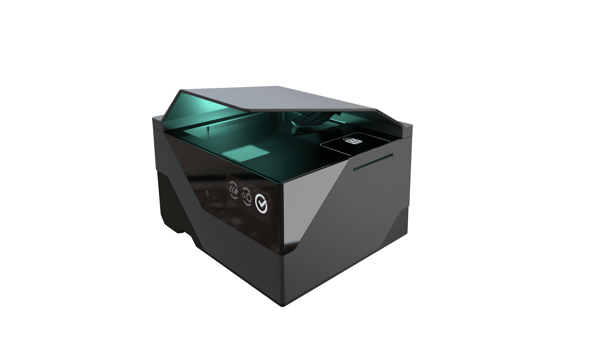
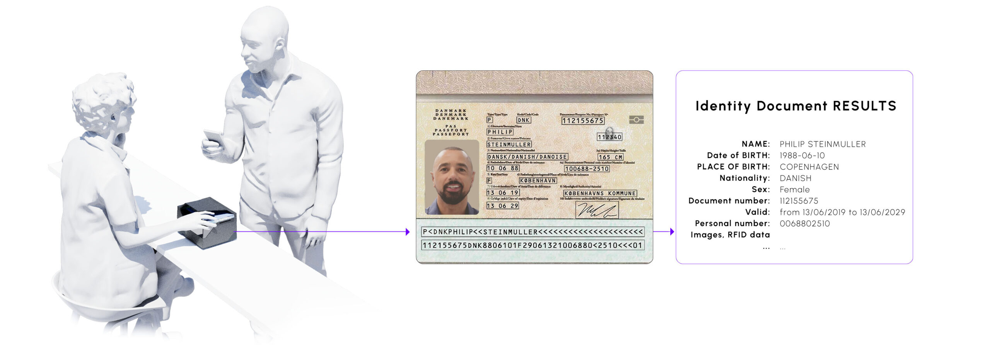
Passport Readers & ID Scanners
ID Verification Made Easy
Devices for scanning, reading, and authentication of ICAO-standard and non-ICAO standard international travel and ID documents, boarding passes, and more.
High-resolution images of documents
Visualization of tactile and invisible security features
Handling of data stored in the machine-readable zones of documents
Handling of data stored on RFDI chip
Extraction of relevant data for further processing
Confidential - property of Adaptive Recognition Hungary Inc.

Slide 15
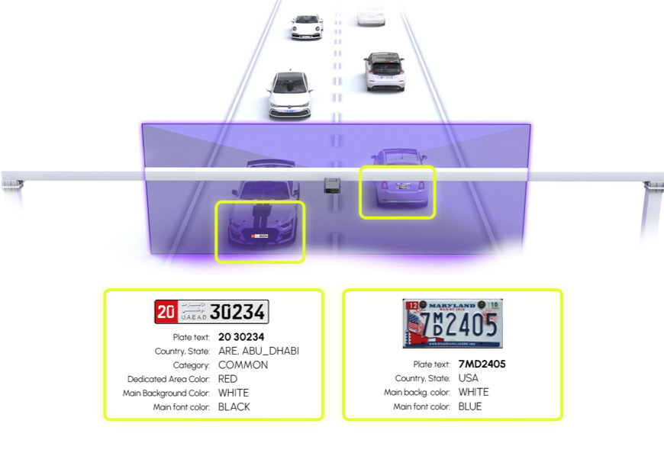
Plate Recognition Software
Intelligent Traffic Analysis
Plate recognition (ANPR, LPR) software with worldwide plate and character coverage in multiple versions. Regularly updated databases
API (on-premis)
Cloud-based
Mobile Application
Plug & Play
NVIDIA Jetson-based
Vehicle Make and Model Recognition Software
Confidential - property of Adaptive Recognition Hungary Inc.

Slide 16
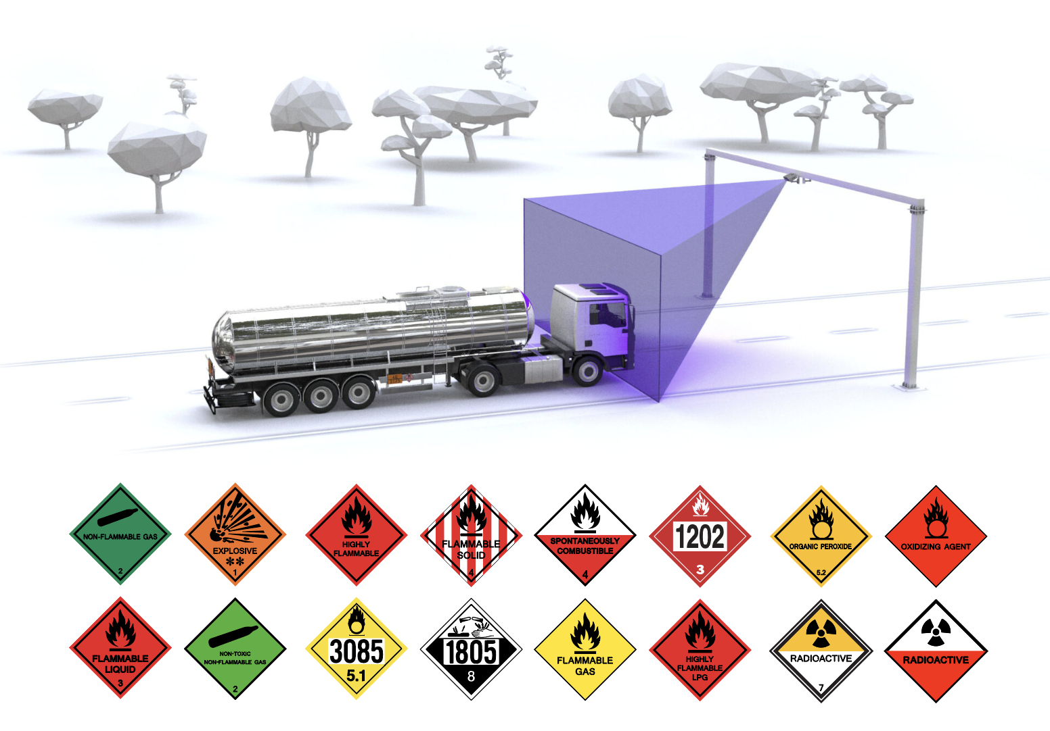
Industrial Code Recognition Software
Code Reading and Goods Tracking
Worldwide recognition and processing of container codes used in goods transport, dangerous goods signs, railway codes, and USDOT codes for commercial vehicles
Confidential - property of Adaptive Recognition Hungary Inc.

Slide 17
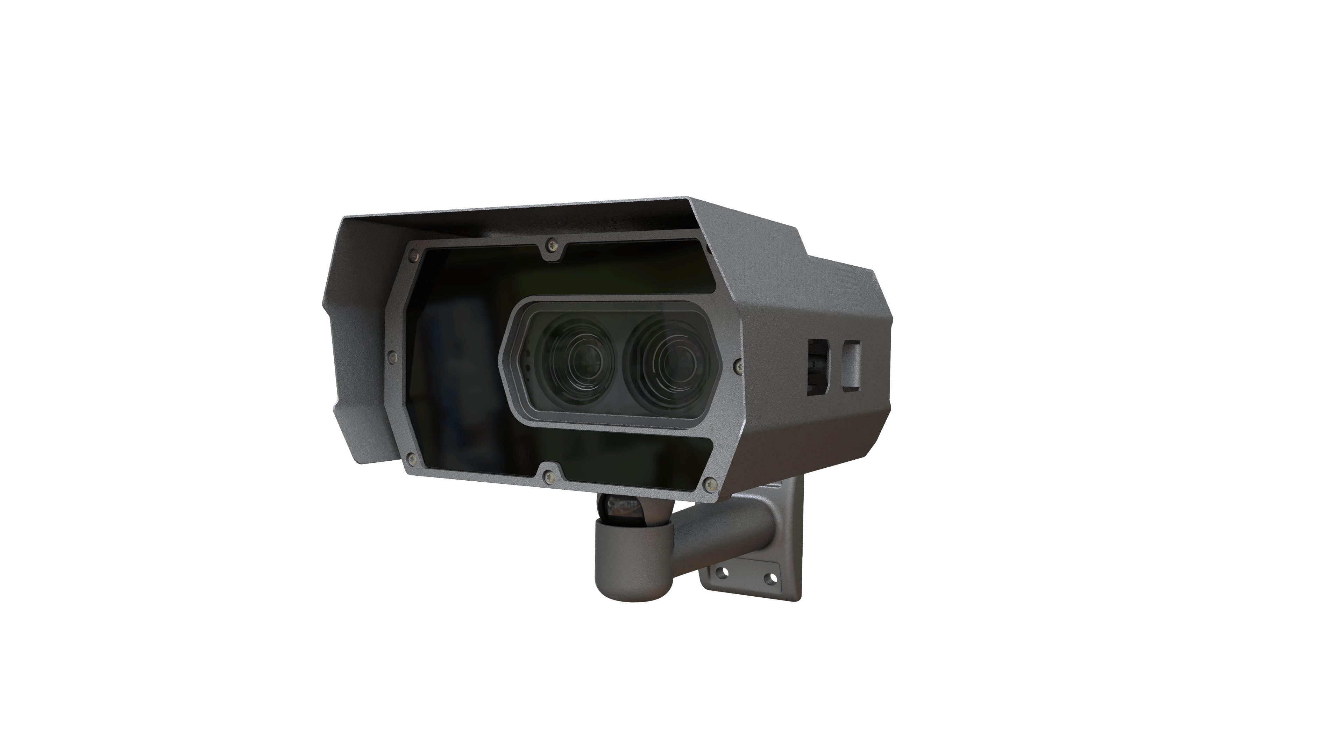
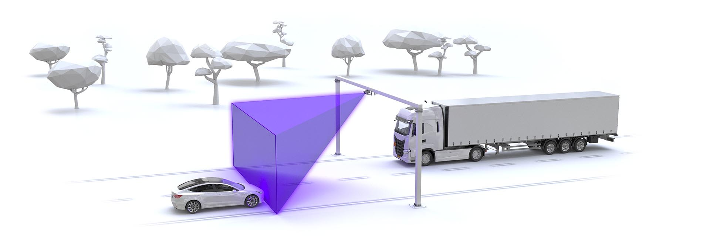
Traffic Monitoring Cameras
Cameras With Embedded Intelligence
Fixed and portable cameras with onboard plate recognition intelligence for traffic monitoring, highway tolling systems, and security and law enforcement applications.
Cameras especially developed for axle counting, passenger counting, and container code reading.
Designed to take ideal images for plate recognition
Embedded triggering solutions
Optional make and model recognition
Confidential - property of Adaptive Recognition Hungary Inc.

Slide 18
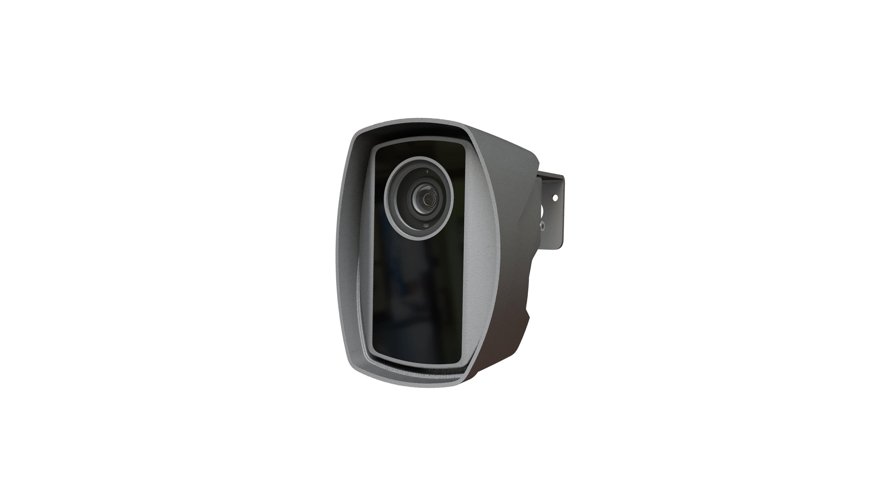
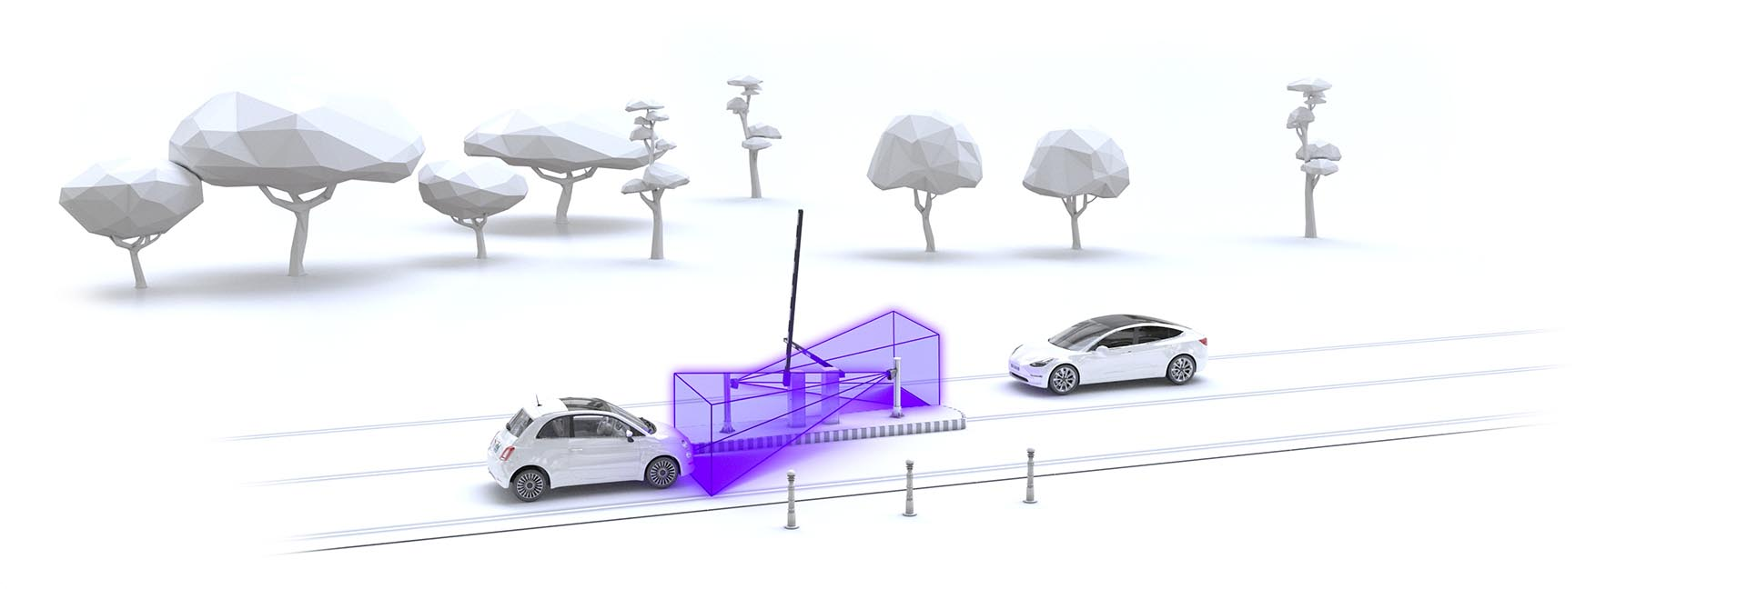
Parking Access Control & Other Cameras
Cameras With Embedded Processing
Easy-to-use, no-loop plate recognition cameras especially designed for slow traffic and parking access control.
Mobile, car-mounted cameras for on-the-go plate recognition and traffic analysis.
Fixed and portable speed cameras equipped with multi multilane radar.
Confidential - property of Adaptive Recognition Hungary Inc.

Slide 19



Thank You
Adaptive Recognition Hungary INC.
41 Alkotás Street
1123 Budapest, Hungary
+36 1 201 9650
www.adaptiverecognition.hu
Confidential - property of Adaptive Recognition Hungary Inc.

